Slide 1


Slide 2
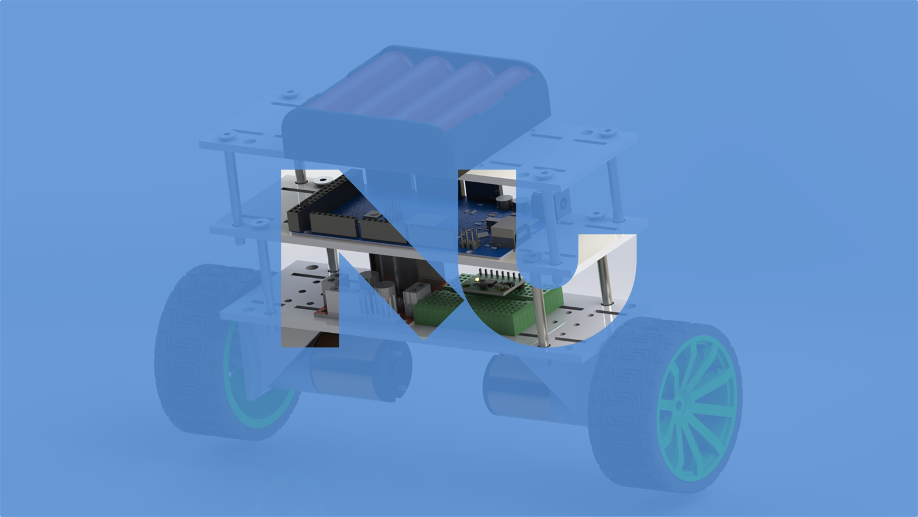

Slide 3
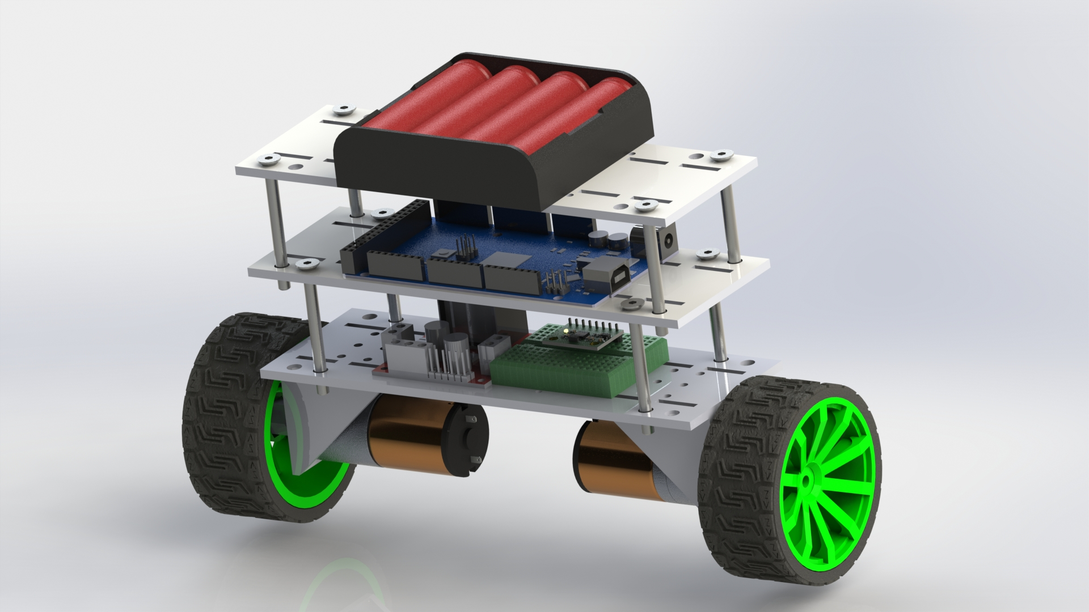
SELF-BALANCING ROBOT
MICROCONTROLERS
Dr. Mahmoud El Samanty | Eng. Hossam Hassan
Berit Adina Händel 171018
Gabriel de Brito Silva 171020
Hedaya Ali 171103
Mohd Saiful Akmal Bin Razali 171021

Slide 4


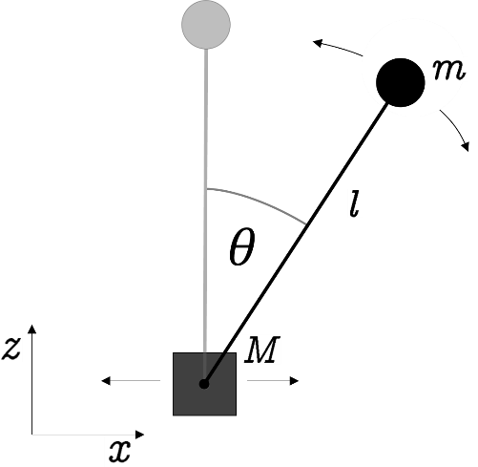
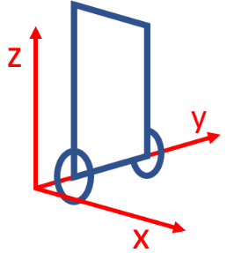
Inverted Pendulum
Theoretical
Analysis
we assume that the robot is mainly unstable in rotation around the wheel axis. Therefore, the model becomes 2-diminsional (z- and x-axis) and 2-DOF (position on x-axis and inclination angle).
The pendulum consists of a mass, which is connected to the base’s mass. The pendulum can freely rotate around the joint point and the base’s mass can be move along the x-axis

Slide 5



Inverted Pendulum
Theoretical
Analysis
$$L=T+V=\frac{1}{2} M {\dot{x}}_{M}^{2}+\frac{1}{2} m \left({\dot{x}}_{m}^{2}+{\dot{z}}_{m}^{2}\right)+\frac{1}{2} J {\dot{θ}}^{2}−m g z_{m}$$
kin. energy of mass M
kin. energy of mass m
rot. energy of mass m
pot. energy of mass m
$$\frac{d}{dt} \left(\frac{∂L}{∂\dot{θ}}\right)−\frac{∂L}{∂θ}=−β\dot{θ}$$
damping of the pendulum
$$\ddot{θ}=\frac{1}{2 l}\left(−\frac{β}{m l} \dot{θ}+g\sin\left(θ\right)−\cos\left(θ\right) \ddot{x}\right)$$

Slide 6
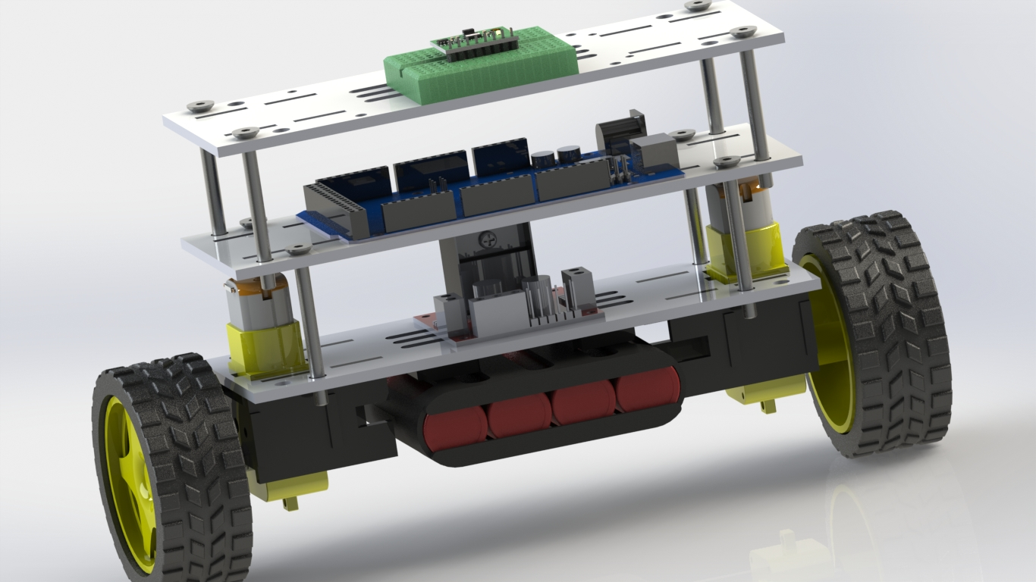
FIRST VERSION

Slide 7
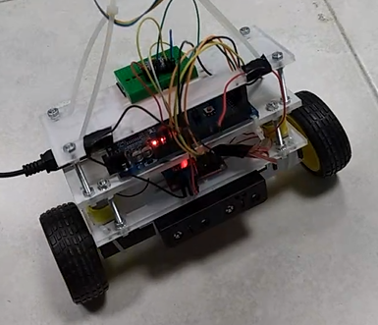
FIRST VERSION

Slide 8
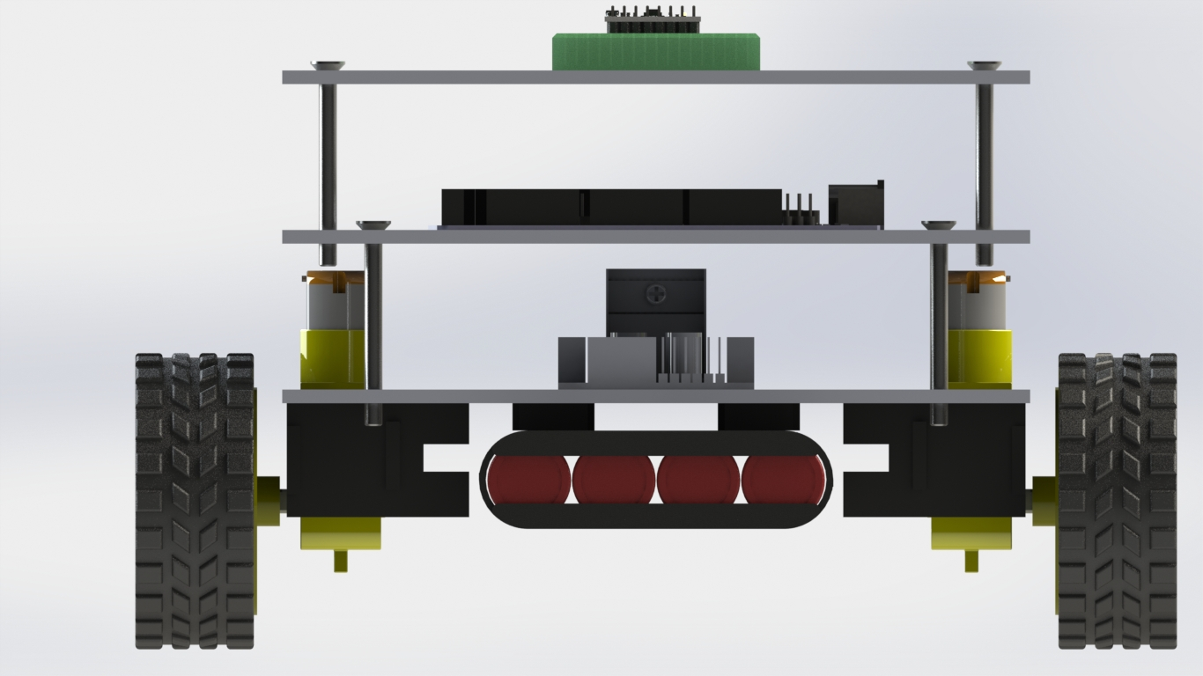
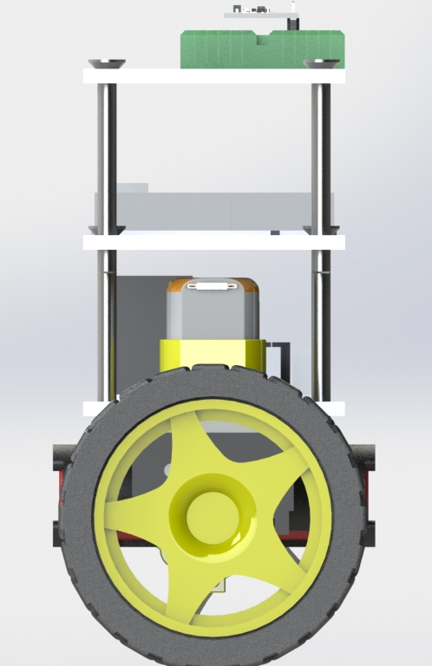
NOME DO APRESENTADOR

Slide 9
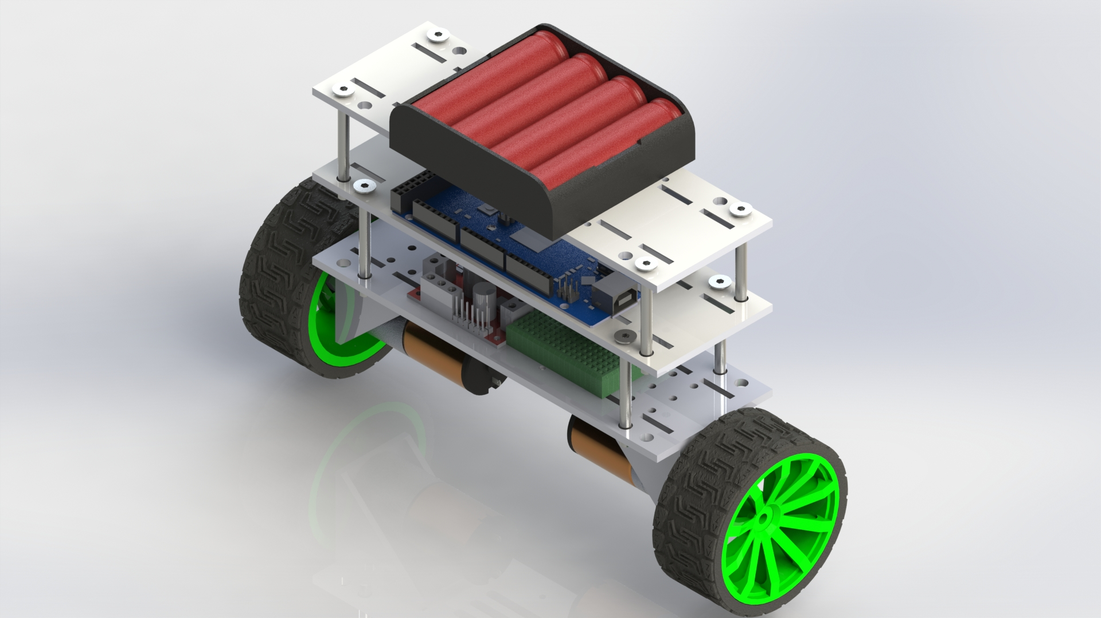
ACTUAL VERSION

Slide 10
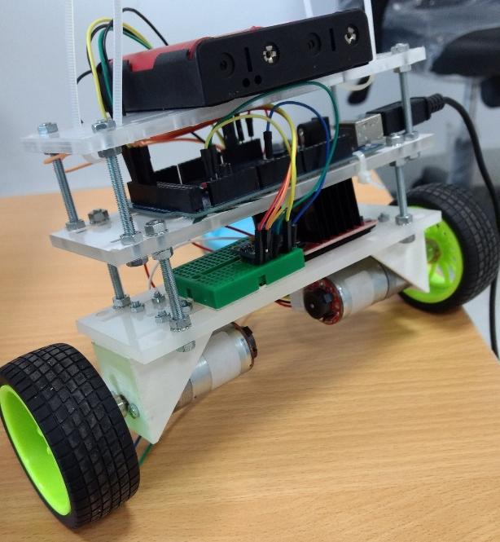
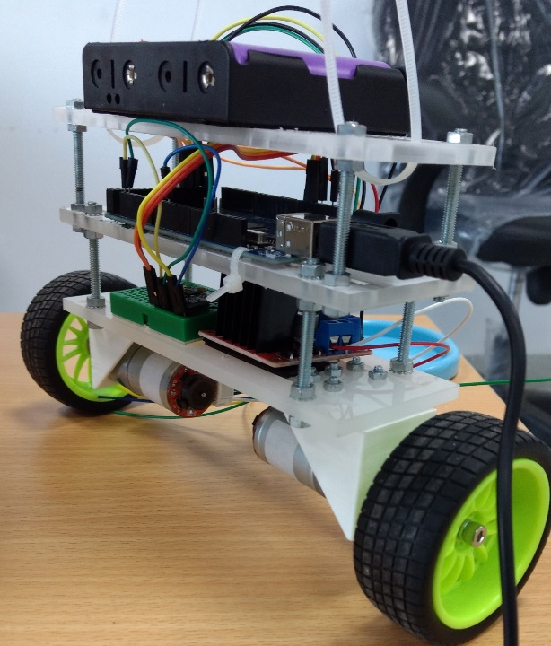
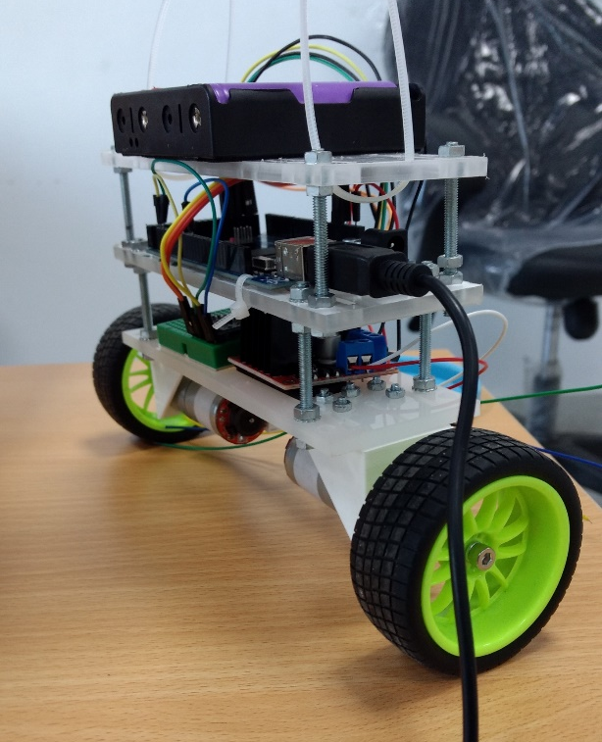
ACTUAL VERSION

Slide 11
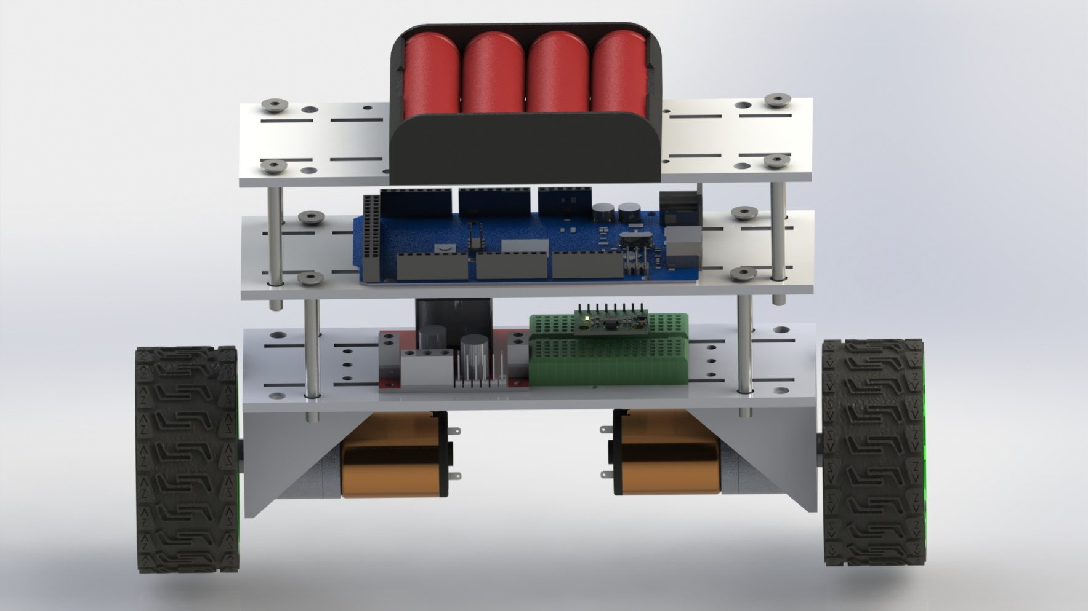
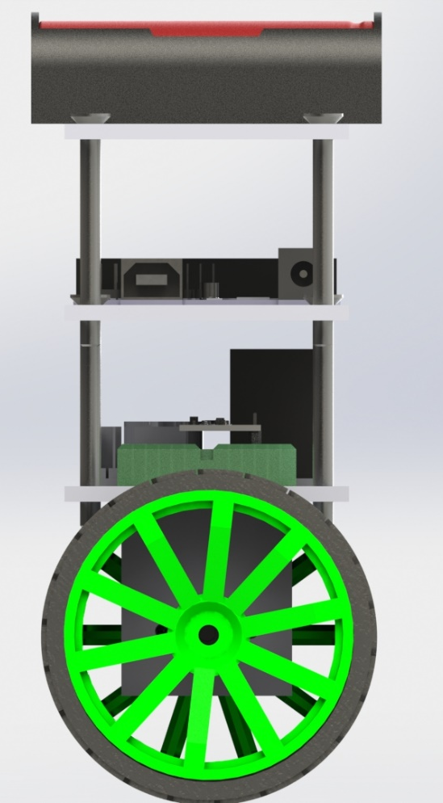
NOME DO APRESENTADOR

Slide 12

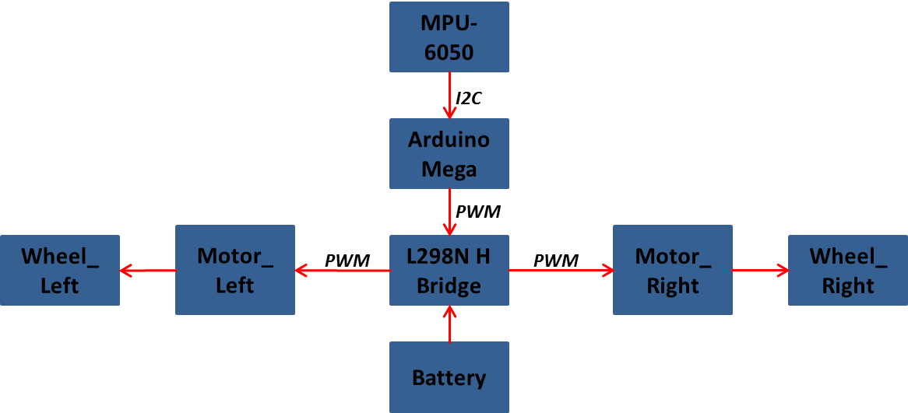
Components and connections

Slide 13

Sed gorilla ullamcorper facilisis interdum. Sed id sem a est iaculis pulvinar at sit amet diam. Fusce ac lacus tempor, cursus enim quis, auctor urna. Vestibulum pulvinar scelerisque dolor, eu eleifend diam feugiat vel. Morbi enim erat, aliquet ut malesuada eu, tempor vel sem.

Slide 14



THANK YOU
Erasmus Mundus Students (2017-2019)
Master in Mechatronics and Micromechatronics Systems
Nile University - Egypt
Fall/2017

